Slide 1

Force Scaling in Rehab
Rehabilitation Engineering
Thorbjörn Höllwarth, Michel Vogt
Supervisor: Nadine Dominik
19th of December 2024, ETH Zürich
Physical Human Robot Interaction

Slide 2
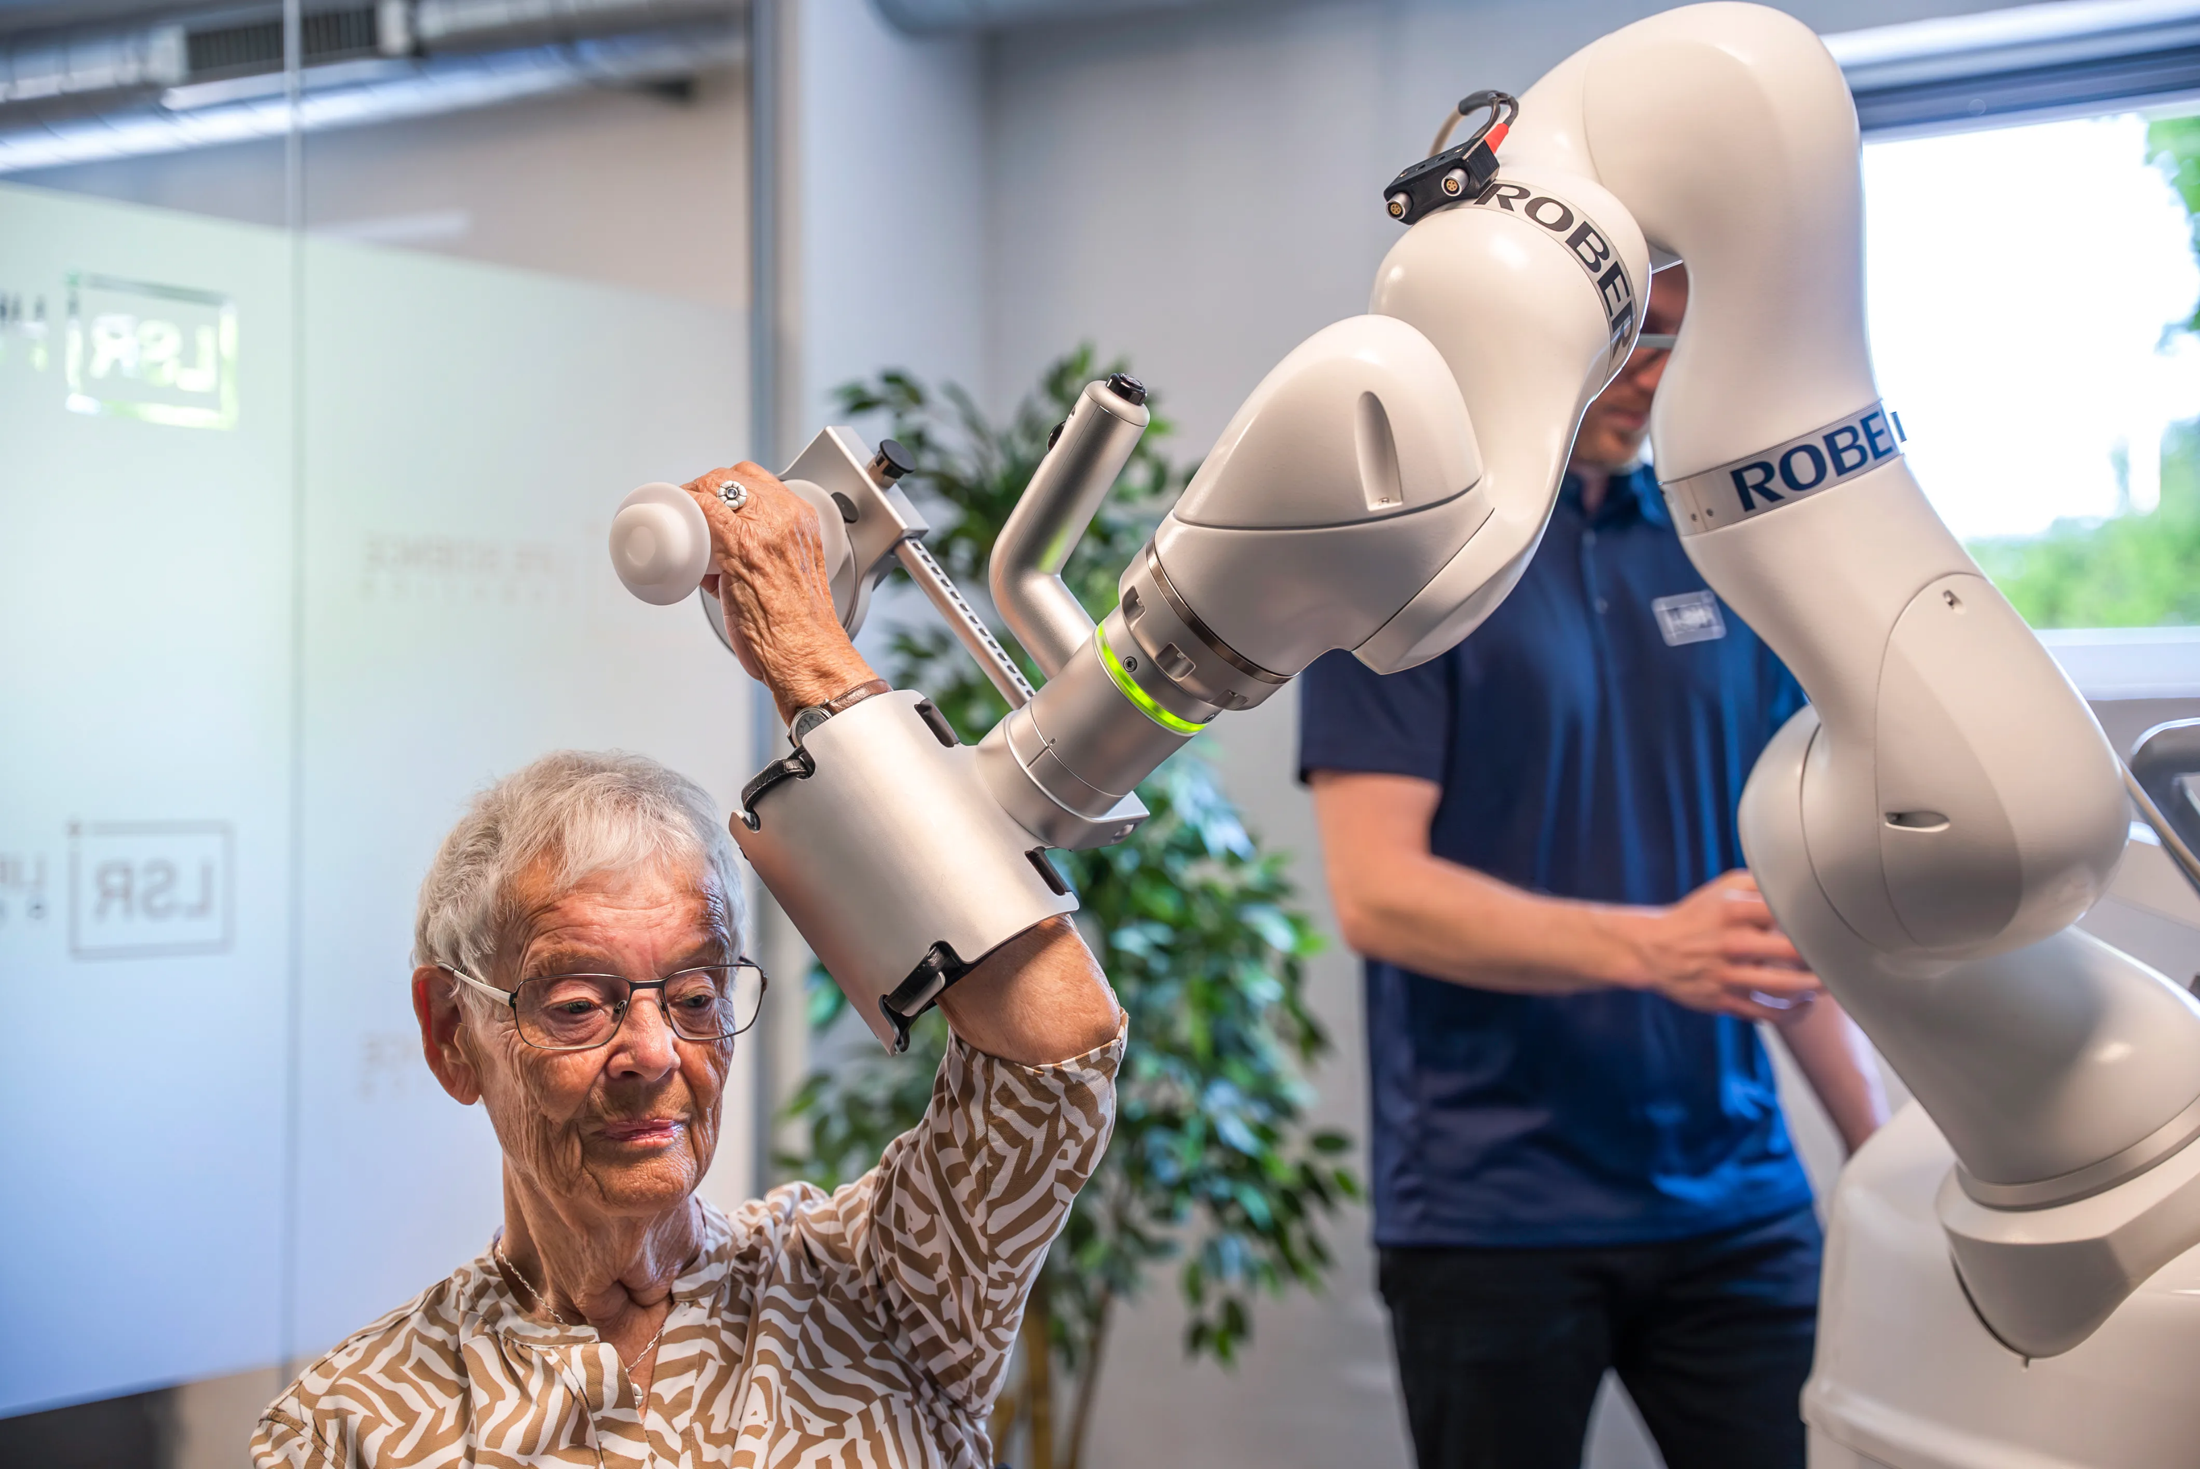
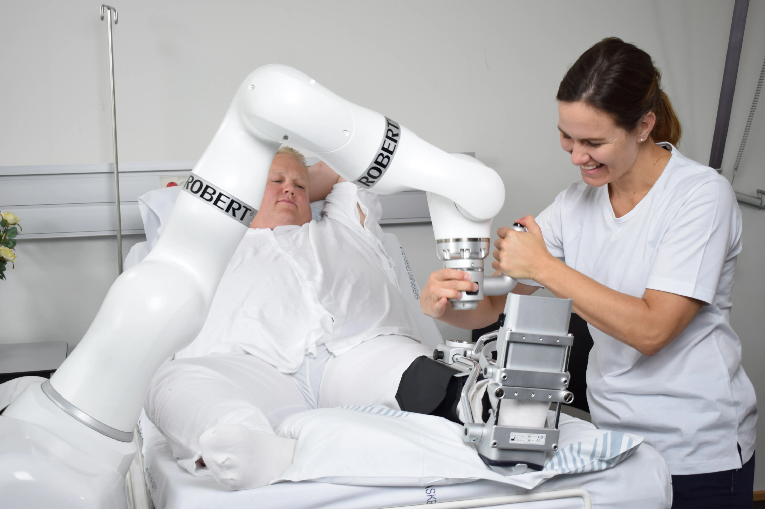
Introduction
ROBERT ^{[1]}
Notes:
Robotic therapy aids recovery in stroke patients and supplements physiotherapy.
Manipulating visual feedback about performed work can help subjects break self-imposed limits in physical therapy.
This study had two parts with 4 subjects:
Determine the just-noticeable-difference (JND) in force using a haptic paddle.
Assess how visual distortion influences perceived effort.

Slide 3
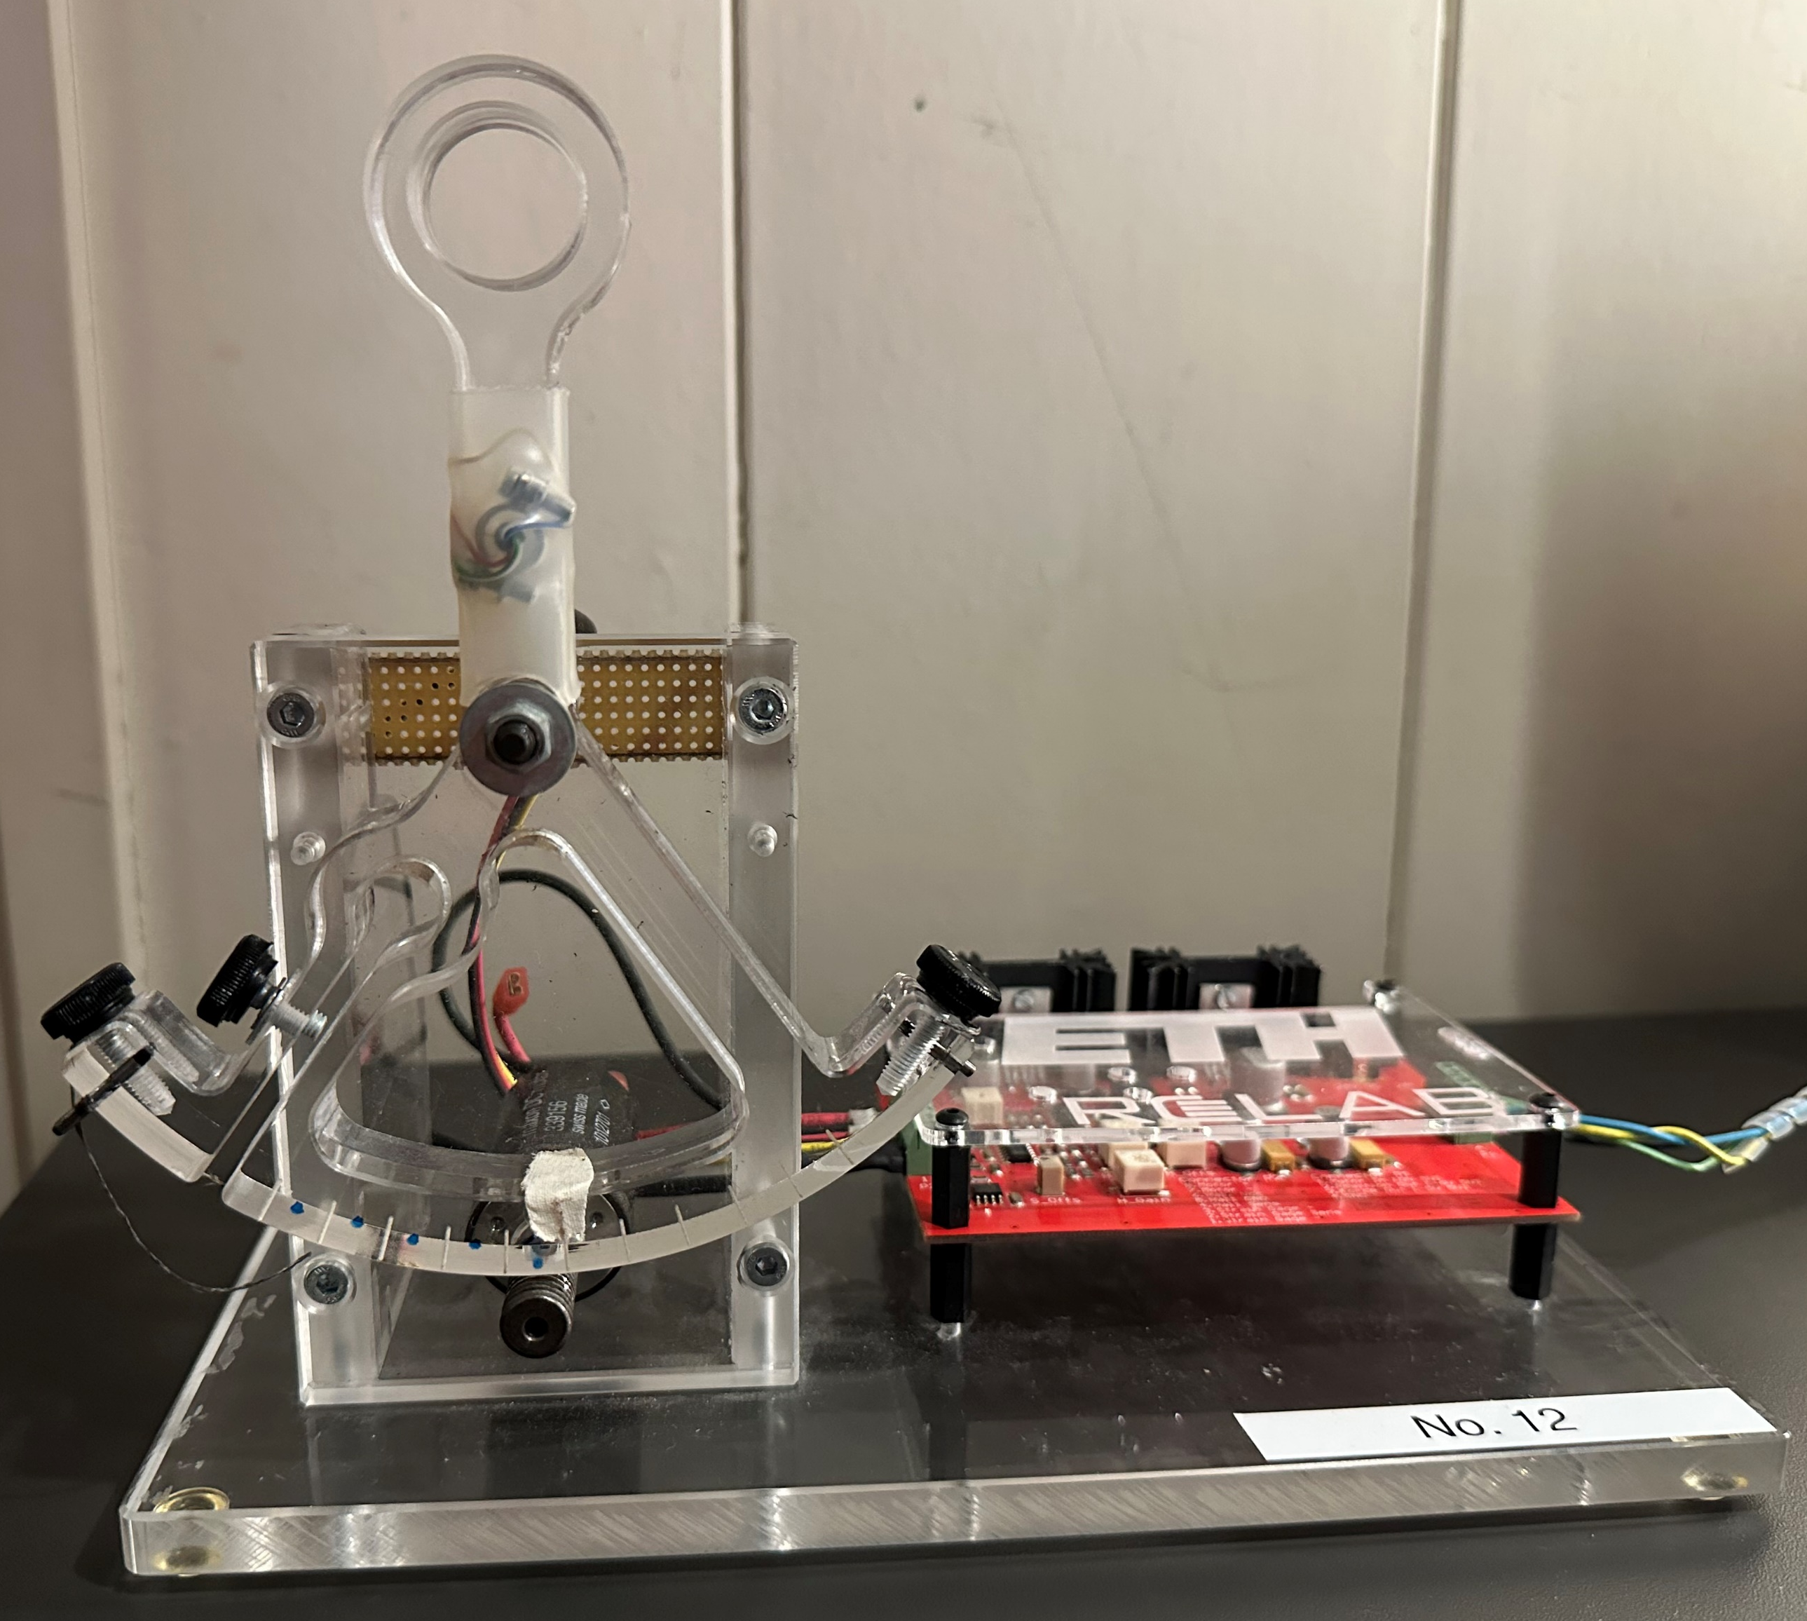
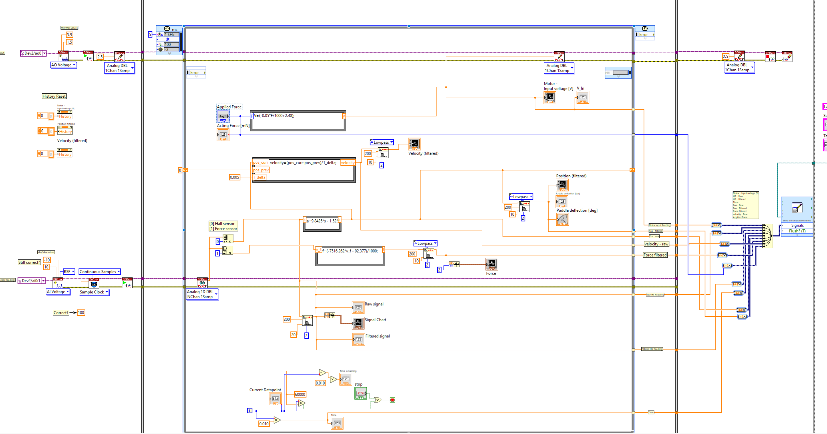
Methods – Setup I
Haptic Paddle
With markings at ceratin angles for experiment 2
Integrated strain gauge
Screw engine
Rod to connect motor forces to the paddle
LabView

Slide 4
Methods – Setup II
Characterisation
Force sensor transfer function
Measure gauge voltage using known weights
Desired force transfer function
Measure force across multiple motor voltages
Notes:
Haptic paddle used with an integrated strain gauge to apply controlled forces.
Characterization steps:
Measure the transfer function of the strain gauge.
Calibrate the motor force applied to the paddle handle.
LabVIEW + DAQ were used for signal control and data acquisition.
Subjects: 4 participants, aged 20-25 years, with no hand impairments.

Slide 5
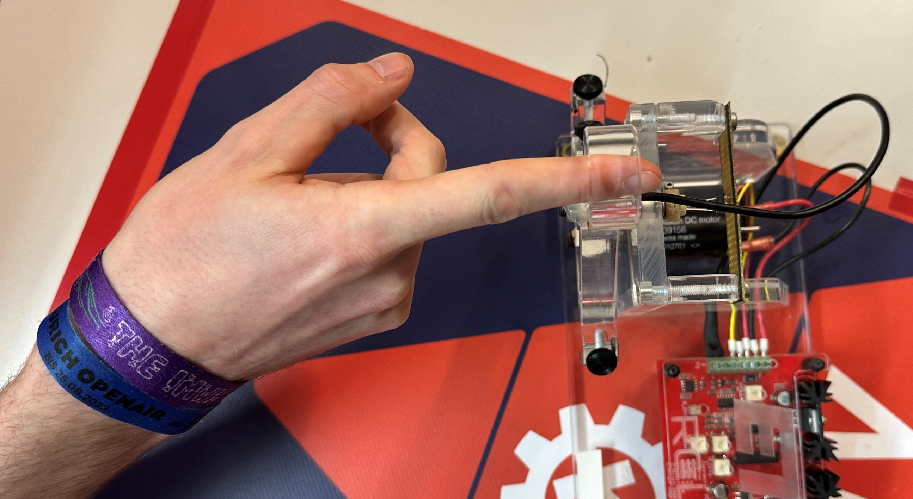
Methods – Exp. 1: Just-Noticable-Difference Determination
Subject
Place elbow on the table
Position right hand index finger in paddle hole
Keep the hand as steady as possible
Workflow
Apply a reference force of 2 Newtons
Add and subtract a delta force pair to/from the reference force for 2 seconds
Return to the reference force
60 trials per subject
Evaluation
After each delta pair, ask: "Was force 1 stronger, force 2 stronger, or no difference?"
F_{Paddle}
Delta Force Pair | Deviation | Strong Signal | Weak Signal
D1 | 0.25 N | 2.125 N | 1.875 N
D2 | 0.35 N | 2.175 N | 1.825 N
D3 | 0.45 N | 2.225 N | 1.775 N
D4 | 0.55 N | 2.275 N | 1.725 N
D5 | 0.65 N | 2.325 N | 1.675 N
D6 | 0.75 N | 2.375 N | 1.625 N
Notes:
Aim: Determine the smallest force difference a subject can perceive.
Subjects used their index finger for consistency and comparability with literature.
Experiment setup:
Subjects hooked their index finger into the paddle loop and kept it still.
100 trials: Two forces applied for 2 seconds each, in random order.
Subjects answered if the forces were the same or identified the higher force.
Forces were symmetrically applied around a 2 N reference force (values shown on slide).
Paddle held at zero position, and no feedback was given to avoid biases.
Explain JND
Random
Allgemeint subject fragen

Slide 6
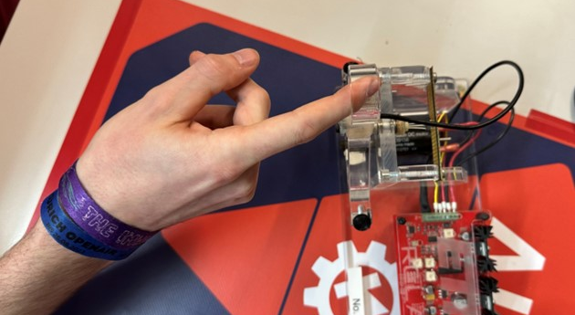
Methods – Exp. 2: Force Distortion
F_{Paddle}(Pos)
Subject
Place elbow on the table
Position right hand index finger in paddle hole
Keep the hand as steady as possible
Only flex the index finger
Workflow
Start at zero-position
For each distortion level:
Tell subject to flex their finger, until the paddle has reached position [1, 2, 3, 4]
Hold each angle for 5 seconds, return to 0-position inbetween
64 trials per subject
Evaluation
After each return, ask: “How would you rate your effort at this mark? [1 = minimum effort, 10 = maximum effort]”
Effort = energy usage, exertion, fatigue
α_{position}
Distortion Level | Force at 6.5° | Force at 13° | Force at 19.5° | Force at 26°
0% | 1.50 N | 2.00 N | 2.50 N | 3.00 N
7% | 1.61 N | 2.14 N | 2.68 N | 3.21 N
15% | 1.73 N | 2.30 N | 2.88 N | 3.45 N
22% | 1.83 N | 2.44 N | 3.05 N | 3.66 N
Notes:
Aim: Determine if visual feedback influences perceived effort.
A virtual spring applied controlled forces at specific angles of the paddle (values shown on slide).
Experiment setup:
60 trials: Subjects flexed their index finger to a target angle and held it for 5 seconds against the applied force.
Subjects rated perceived effort on a scale of 1 to 10.
Spring constant manipulation:
First 12 trials: Constant spring constant (baseline).
After that: Every second trial increased spring constant by 7%, 15%, or 22% without informing the subjects.
This design controlled for muscle fatigue vs. intentional force distortion.
Force Distortion Introduction:
…
Effort definition

Slide 7
Results - JND
 | Δ Force (%)
Ratio 50% | 19.17%
Ratio 75% | 30.25%
JND | 11.03%

Slide 8
Results - JND
JND | 10.78 ± 5.95 %

Slide 9
Results – Force Distortion

Slide 10
Results – Force Distortion

Slide 11
Comparison To Literature
JND of Index Finger
JND | Our Study | Brewer et al. (2005) ^{[2]}
Mean | 10.78 ± 5.95 % | 19.70 ± 1.85 %
Min | 6.00% | 12.06%
Max | 19.08% | 31.7%
Why the difference?
Definition of JND
Dynamic vs static
Age of subjects

Slide 12
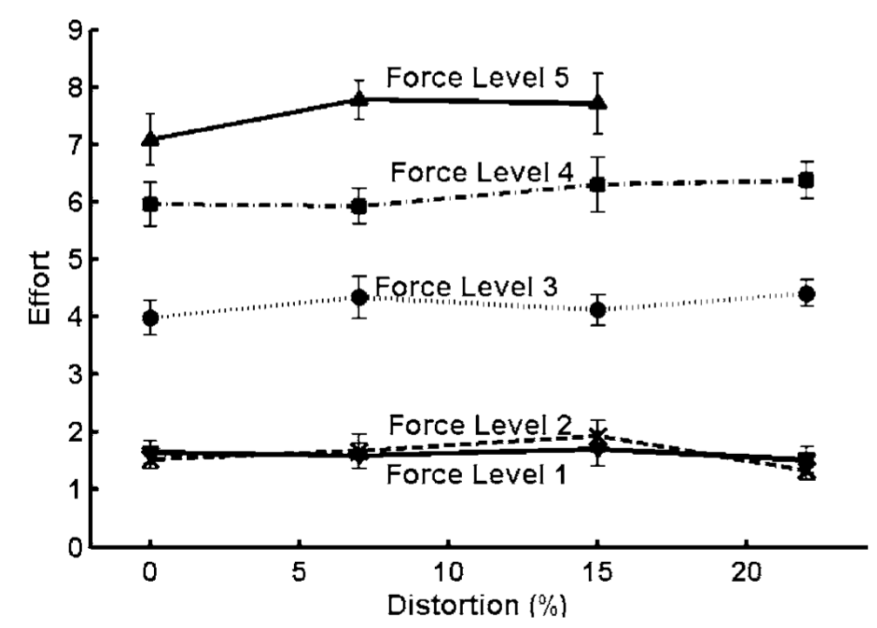
Comparison To Literature
Brewer et al. (2005) ^{[2]}

Slide 13
Limitations
# of subjects
# of trials
Controlled variables
Finger position
Support by other muscle groups
Time spent at force
Paddle position
Muscle fatigue
Response bias
JND | 10.78 ± 5.95 %

Slide 14
Conclusion / Outlook
Key message:
Feedback distortion can be valuable tool in rehabilition
Future work:
Long term studies, bigger muscle groups, subject in rehab

Slide 15
References
[1] unitedrobotics.group
[2] Brewer et al., IEEE transactions on neural systems and rehabilitation engineering (2024)

